Slide 1
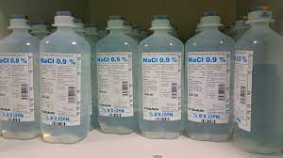
Fundamentals of Nursing(1st Stage)
Intravenous Fluid(I.V) (Practice)
Lecture 4
University of Basrah –College of Nursing – Fundamentals of Nursing Department

Slide 2
Introduction
A relatively common form of therapy for handling fluid disturbances is the use of infused intravenous solutions. The physician or other licensed health care professional with prescriptive privileges is responsible for prescribing the type and volume of solution to be administered.
The nurse is responsible for initiating, monitoring, and discontinuing the therapy. The nurse is also responsible for critically evaluating all patient orders prior to administration.

Slide 3
Definition of I.V fluids
Chemically prepared solutions that are administered to a patient through the I.V site.
Types of I.V fluids
1- Colloids (Dextran, Hetastarch, Albumin)
2- Blood products ( Fresh frozen plasma (FFP). Plasma protein fraction (PPF). Packed red blood cells (PRBCS). Whole blood )
3- Crystalloids

Slide 4
Crystalloids
Crystalloid Solutions is the primary fluid used for prehospital I.V therapy. Crystalloids contain electrolytes (e.g sodium, potassium, calcium, chloride) but lack the large proteins and molecules found in colloids. Crystalloids come in many preparations and are classified according to their “tonicity"

Slide 5
A crystalloid’s tonicity: describes the concentration of electrolytes dissolved in the water, as compared with that of body plasma fluid surrounding the cells.
When the crystalloid contains the same amount of electrolytes as the plasma, it has the same concentration and is referred to as “isotonic” concentration.

Slide 6
If a crystalloid contains more electrolytes than the body plasma, it is more concentrated and referred to as “hypertonic” concentration.
when a crystalloid contains fewer electrolytes than the plasma, it is less concentrated and referred to as “hypotonic” concentration.

Slide 7
Common crystalloids
0.9% Sodium Chloride also called Normal Saline (NaCl)
Type: Isotonic
Not desirable as routine maintenance solution because it provides only Na+ and Cl−, which are provided in excessive amounts.
Uses
May be used to expand temporarily the extracellular compartment if circulatory insufficiency is a problem;
Used to treat hypovolemia, metabolic alkalosis, hyponatremia, hypochloremia,diabetic ketoacidosis (DKA), hypercalcemia
Used with administration of blood transfusions

Slide 8
Nursing considerations
Can lead to overload
Use with caution in patients with renal failure, heart failure or edem.

Slide 9
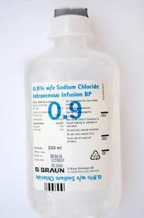

Slide 10
Dextrose 5% in water (D5W)
Type: Isotonic
Supplies about 170 cal/L and free water (contains 50 g of glucose)
Uses
Fluid loss
Dehydration
Hypernatraemia

Slide 11
Nursing considerations
Can cause fluid overload
Contraindicated in head injury because it may result in an increased intracranial pressure.
Use with caution in renal and cardiac patients.
Should not be used in excessive volumes because it does not contain any sodium; thus the fluid dilutes the amount of sodium in the serum.
Brain swelling, or hyponatremic encephalopathy, can develop rapidly and cause death unless it is promptly recognized and treated.

Slide 12
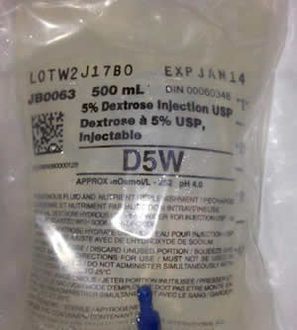
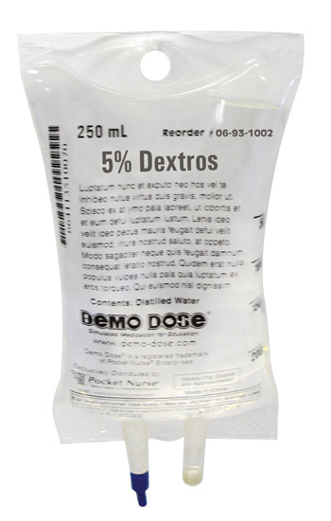

Slide 13
Lactated Ringer’s solution
Type: Isotonic
Contains multiple electrolytes in about the same concentrations as found in plasma
Uses:
Hypovolemia
Burns
Fluid lost as diarrhea, acute blood loss.
Useful in treating metabolic acidosis

Slide 14
Lactated Ringer’s solution
Nursing considerations
Don’t used for renal failure patient because it contains potassium and can cause hyperkalemia.

Slide 15
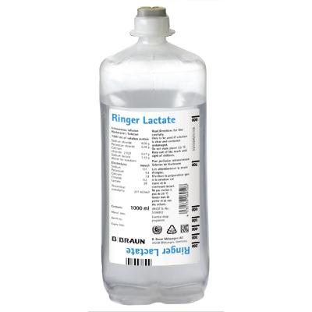

Slide 16
0.45% Sodium Chloride ( half – strength saline )
Type: Hypotonic
A solution that provides Na+, Cl−, and free water
Uses:
Used as a basic fluid for maintenance needs
Often used to treat hypernatremia (because this solution contains a small amount of Na+, it dilutes the plasma sodium while not allowing it to drop too rapidly
Gastric fluid loss from NG tube or vomiting
Water replacement
DKA
Nursing considerations
May cause cardiovascular collapse
increased intracranial pressure.

Slide 17
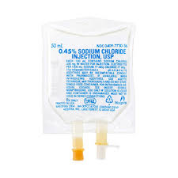

Slide 18
Dextrose 5% in normal saline
Type: Hypertonic
Uses: Temporary treatment from shock
Nursing considerations: Contra-indicated for cardiac or renal patients.

Slide 19
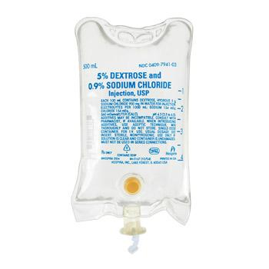

Slide 20
Dextrose 10% in water (D10W)
Type: Hypertonic
Uses:
Water replacement
Conditions where some nutrition with glucose is required
Nursing considerations: Monitor blood sugar levels.

Slide 21
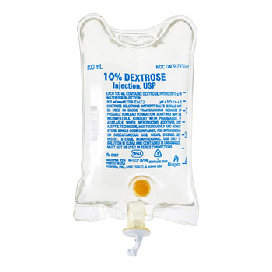

Slide 22
3%, 5% NaCl ( hypertonic saline )
Type: Hypertonic
Uses: hyponatremia
Nursing considerations: administer slowly and cautiously because it can cause intravascular volume overload and pulmonary edema.

Slide 23
Mannitol fluid
Indications
Used in the treatment of patients in the early, oliguric phase of acute renal failure
Cerebral edema
Contraindications
Severe renal disease
Pulmonary edema
Active intracranial bleeding

Slide 24
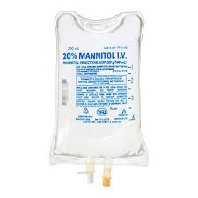

Slide 25
Complications of I.V Therapy
1-Local complications at the site including:
Extravasation
Phlebitis/Thrombophlebitis
Haematoma
Infection
2- Fluid overload
3-Electrolyte imbalance
4-Transfusion reactions
5- Air embolus

Slide 26
THANKS

